Slide 1
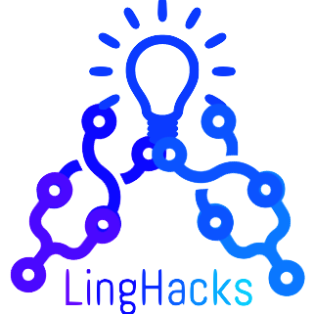
Computational Linguistics Club
Notes:
This is the introduction slide! This would be a good place to introduce yourself, your club’s board members and advisors, and any 30000-foot information about your club, as well as a bit about LingHacks. Feel free to change the title to the name that your club goes by.

Slide 2
Meeting 1: Introduction to Computational Linguistics
[Month Day, Year]
Notes:
This is the intro slide for the first meeting! Briefly say that you’ll be doing an overview of the field of computational linguistics, and also edit the date to be the date on which you’re holding the meeting

Slide 3
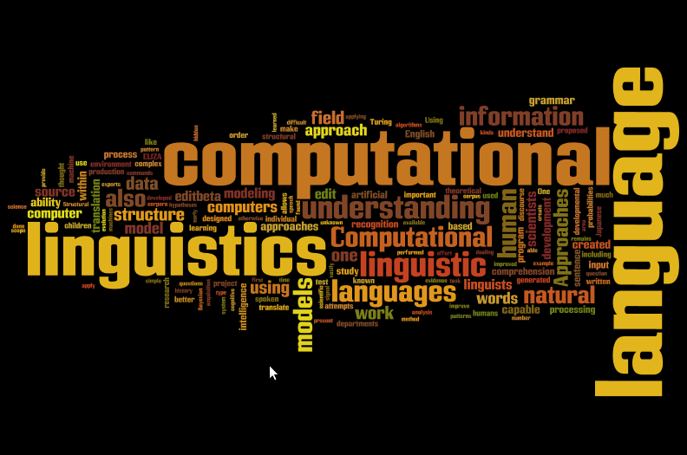
What is Computational Linguistics?
Computer Science
Linguistics
Notes:
Say something to the effect of “computational linguistics is the intersection of computer science and linguistics”

Slide 4
Computer Science
“The study of computers and algorithmic processes, including their principles, their hardware and software designs, their applications, and their impact on society.”
Scientific and practical approach to computation
Notes:
Paraphrase the definitions of computer science listed on the slide (basically define computer science)

Slide 5
Linguistics
Study of language and its structure, nature, and meaning
Involves analysis of language form, language meaning, and language in context
Notes:
Define linguistics!

Slide 6
Computational Linguistics
“Interdisciplinary field concerned with the rule-based modeling of natural language from a computational perspective, in which the techniques of computer science are applied to the analysis and synthesis of language and speech.”
Scientific and engineering discipline concerned with understanding written and spoken language from a computational perspective, and building artifacts that usefully process and produce language, either in bulk or in a dialogue setting.
Notes:
And...define computational linguistics! Basically paraphrase these definitions

Slide 7
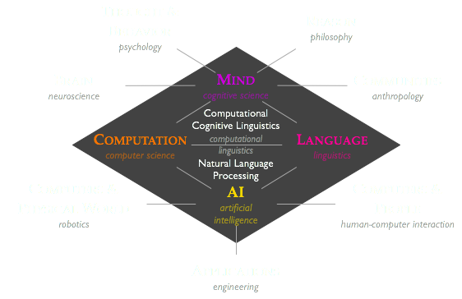
Notes:
Explain how computational linguistics is the intersection of a bunch of disciplines, from neuroscience (because language involves brain activity) to engineering (actually making systems) to human-computer interaction to anthropology/philosophy/studies of people and thought to robotics etc

Slide 8
Careers
Speech Scientist
Artificial Intelligence Lab Researcher
Machine Learning Engineer
Machine Translation Researcher
Language-based Software Engineer/NLP Developer
Language Modeling Researcher
Notes:
Outline the potential career paths that involve computational linguistics!
Speech scientists: work on speech recognition systems like Siri, Alexa, etc
AI Lab Researcher: academic work or corporate lab work involving research in artificial intelligence
Machine Learning Engineer: intersection of software engineering (aka developing and designing software) and implementing machine learning algorithms, essentially putting research into practice and developing real-world applications
Machine Translation Researcher: work on both academic and industry problems in machine translation (think Google Translate)
Language-based Software Engineer/NLP Developer: another cross between software engineering and AI, focused on NLP algorithms
Language Modeling Researcher: huge area of academic (and corporate) research, investigating how language/cognitive processes can be modeled or simulated with computers

Slide 9
Real-World Applications
Virtual Assistants: Siri, Alexa, Cortana, Google Home
Speech Synthesis & Enhancement: Stephen Hawking, Sign Language Glove
Machine Translation: Google Translate
Speech Recognition: Dragon NaturallySpeaking, Apple Dictation
Sentiment Analysis & Question Answering: IBM Watson, Tone Analyzer, ChatGPT
Notes:
This slide introduces some real-world applications of computational linguistics!
Virtual assistants: Siri needs to understand what you’re saying (i.e. process your speech) and then do the right command
Speech Synthesis & Enhancement: Stephen Hawking wore one of these so that his speech was understandable; sign language gloves convert sign language motions to spoken language
Machine Translation: pretty self explanatory, need to understand language to translate it to another language
Speech Recognition: also underlies virtual assistants, some companies that produce this software include Dragon, Apple Dictation (essentially, this is the task of converting speech to text)
Sentiment Analysis & Question Answering: given some text/speech, analyze whether it has a positive or negative sentiment; given a question, answer it
Further applications include search engines (google search)

Slide 10
Overview
Fundamentals: intro to Python & basic data processing, intro to linguistics
How computational linguistics works: math, common algorithms, implementations
Standard machine learning algorithms as well as deep neural networks
Computational linguistics applications: chatbots, machine translation systems, speech recognition, spam filters/classifiers
CL + Society: comp ling in a global perspective, applications to social/political issues (e.g. fake news, cyberbullying, ethical questions)
NACLO Prep
Notes:
This slide gives an overview of what the club will cover this year. Basically, we will first go over the fundamentals of Python programming and data processing (as well as a bit of linguistics fundamentals). Then, we’ll do a few deep dives into common computational linguistics algorithms and applications. After that, we also have lessons in North American Computational Linguistics Olympiad (NACLO) prep (more info at nacloweb.org), as well as some paper discussions on research at the intersection of computational linguistics and broader societal implications

Slide 11
NACLO
North American Computational Linguistics Olympiad
Competition in which you solve linguistic puzzles
Learn about the diversity and consistency of language, while exercising logic skills
Registration & info: http://nacloweb.org
Notes:
Introducing NACLO! Basically read the slide & direct people to more info

Slide 12
Downloading the Software
Download Python - Python 3 (3.6+ is fine)
Open IDLE (Integrated Development and Learning Environment)
https://www.python.org/downloads/
Download Pycharm
https://www.jetbrains.com/pycharm/download/#section=mac
Or use any text editor, such as Sublime
https://www.sublimetext.com/3
Notes:
Go over instructions on downloading software (see further instructions in the Computational Linguistics Club Software Instructions document)

Slide 13
Installing Packages
Open Terminal
pip install -U pip
pip install numpy
pandas, scipy, matplotlib, nltk, scikit-learn, tensorflow, keras
Notes:
More instructions on installing software

Slide 14
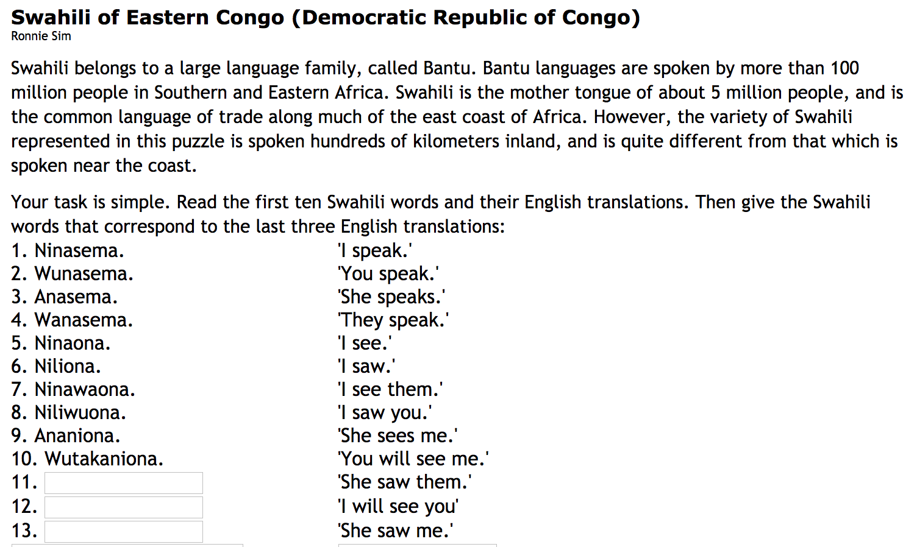
Practice Problem
Notes:
This is a sample problem! The idea is to give students some time to solve it (may want to consider rewards like candy, though this is probably not possible virtually)
Answers: Aliwaona, Nitakawuona, Aliniona.

